Slide 1
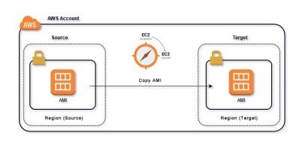
Migrating Instance

Slide 2
Migrating Instance Lab
1) Instance migration one subnet to other
2) Instance migration one account(Dev) to other(Prod)
3) Instance migration one region to other

Slide 3
1) Migrating Instance one subnet to another
a) Launch Instance in ap-south-1a
b) Take image of the instance
c)Crete a new instance from this image and select other subnet(ap-south-1b) –and follow normal installation steps.

Slide 4
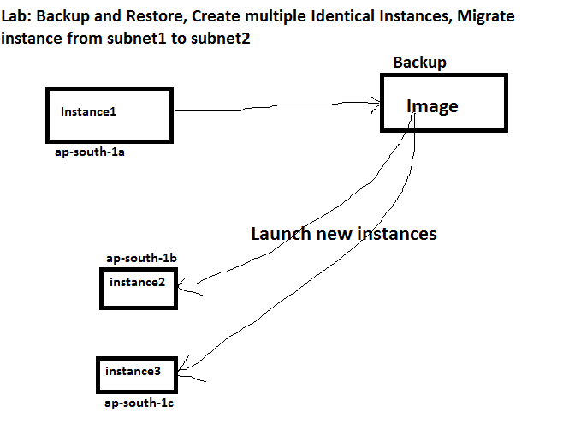

Slide 5
2) Migrating Instance one account to other
a) Launch Instance in ap-south-1a
b) Take image of the instance
c) Go to AMI –select the AMI image –Action –modify permission– aws account number –type the other account number –add permission--save

Slide 6
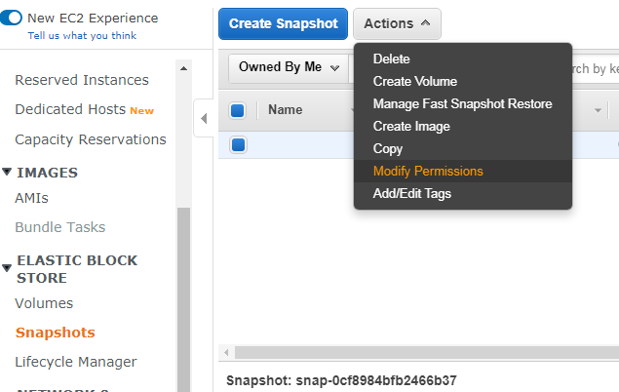

Slide 7
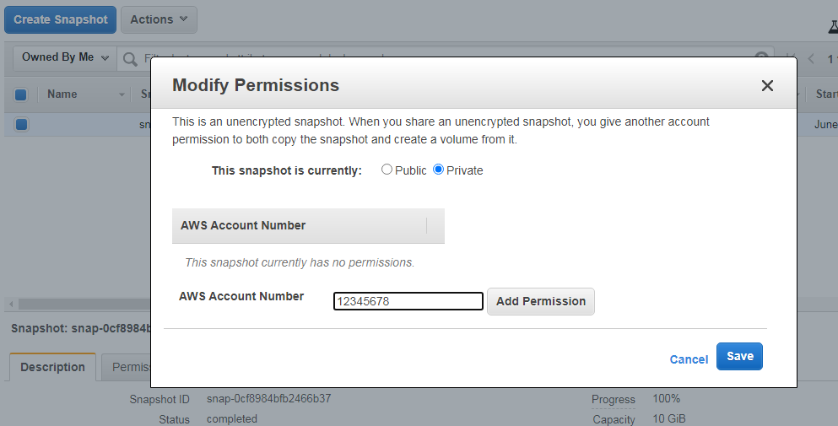

Slide 8
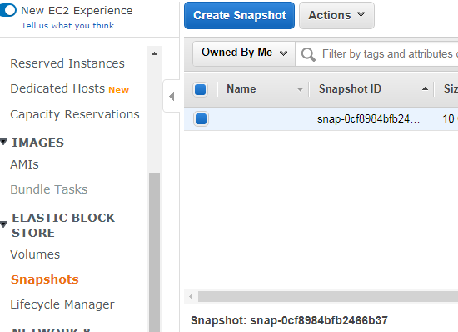
How to check in other account
1) EC2 --- Elastic block store --snapshot—click on owned by me--

Slide 9
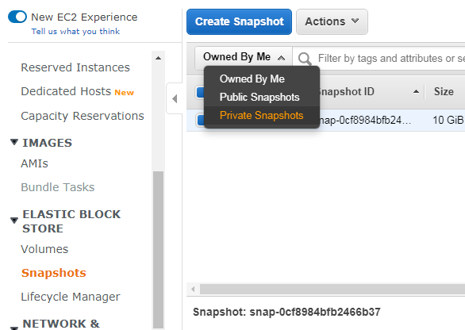
How to check in other account
Owned by me –public snapshot—You will get share snapshot from other account –create image from it and launch instance

Slide 10
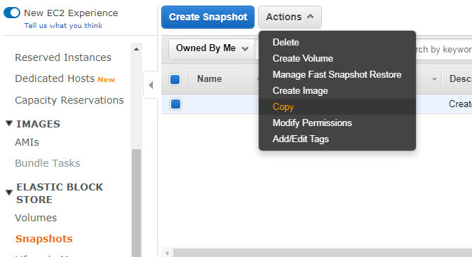
3) Instance migration one region to other
a) Launch Instance in Mumbai region
b) Take image of the instance
c) Go to snapshot –select the snapshot image –Action –copy –select destination region ( Singapore) –ok
d) Now go to singapore –wait for mins—select transferred snapshot—action—create image then launch instance from that image

Slide 11
